Slide 1
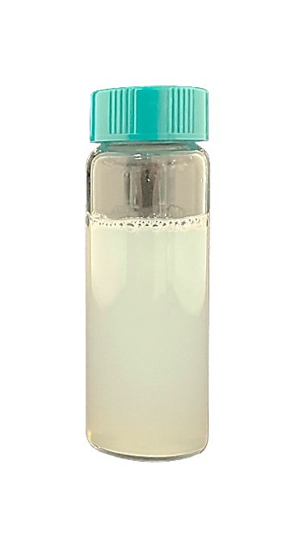
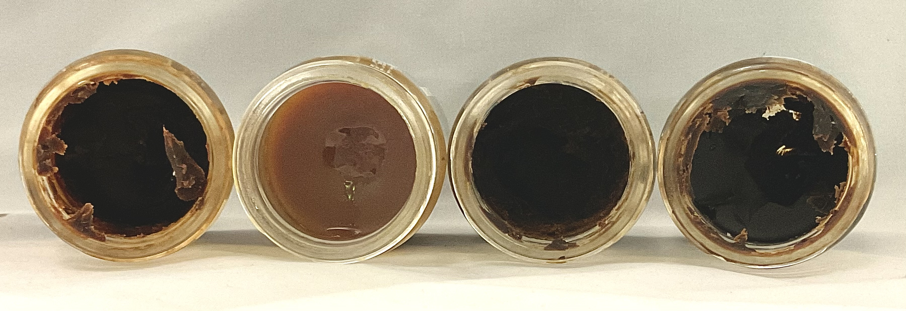
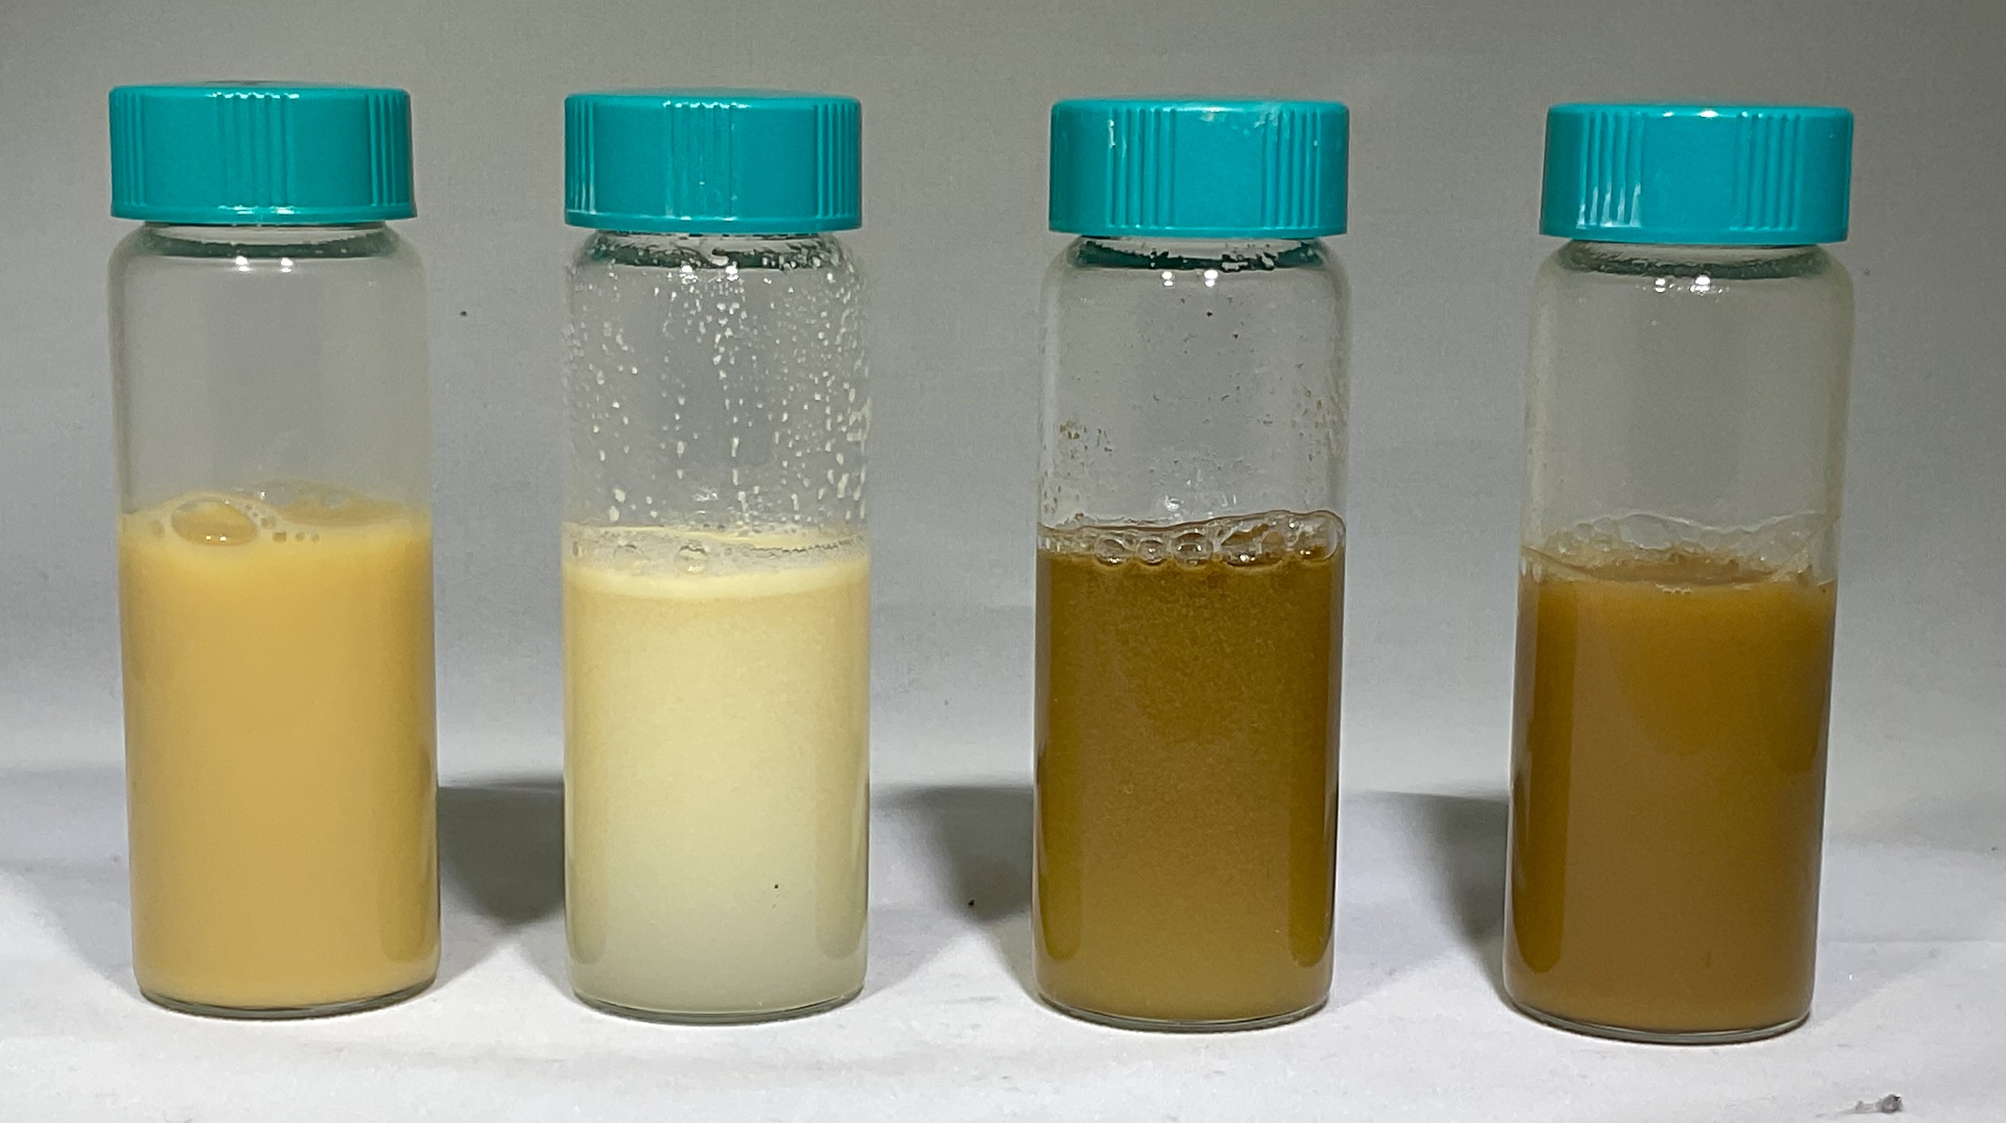
TenEx Technologies offers a suite of exceptional and proprietary technologies to revolutionize the oil & gas industry by focusing on generating the lowest cost per barrel, using innovative and cost-effective products that can be tailored to every reservoir. TenEx develops its products in its very own state-of-the-art full-service laboratory.
Water-based Organic Deposits Remediation
Cost-effective, Non-Toxic, Environmentally Friendly Alternative to Pigging and Organic Solvent Treatments
What is CeraFLO™?
Wells and pipelines get constricted over time because of paraffin and asphaltene deposition, resulting in flow assurance issues. Treating wells and pipelines via pigging or aromatic organic solvents such as xylene and toluene is operationally difficult, expensive, toxic, flammable, non-environmentally friendly, and can create unpredictable mechanical issues.
This newly developed chemical technology is a water-based solution to treat organic deposits in wells and pipelines. It utilizes a proprietary blend to remove organic deposition. It contains surface active agents and nanoparticles. It is a cost-effective, liquid, non-corrosive product with a simple straightforward field implementation.
CeraFLO™ has been lab tested for different kinds of organic deposition from different US Basins with wide success. It is pending field trial.
Surface Active Agents
Nanoparticles
Environmentally Friendly
$
Cost-effective
Simple to Implement
How does CeraFLO™?
This product works by disjoining, dispersing, and emulsifying the organic deposits inside constricted wells and pipelines. This proprietary blend is highly effective in preventing recrystallization of the organic deposits, thus enabling easy flow back of the treated solution.
It can be used as an additive to hot water and recirculated through the wells or pipelines for a short period of time to remove the deposits. The product will be supplied in a liquid form and can be mixed with different water sources.
CeraFLO™ can be implemented in all kinds of pipelines, transfer lines, well metallurgies, downhole equipment, and difficult-to-reach locations.
Solid Organic Deposits from Various Oilfields
Fully Treated Solutions
18 Station Avenue
Berwyn, PA 19312
Phone: 610-484-5566 www.tenextechnologies.com
For more information, please contact us at: sales@tenextechnologies.com

